Slide 1
Clinical Alerts and ADRs - the importance of reporting
Dr Nick Martin and Danny Soo
Acknowledgement: Kerry Fitzsimons
Notes:
The WA Clinical Alert policy was first released in Feb 2014.
This education resource supports the WA Clinical (MedAlert) Policy 2017.
The idea of the policy is mainly to provide a framework and governance around process for clinical alerts and ADR reporting, to ensure that such critical information is reported so that the information on the alert available in a timely manner to treating physician for future admissions so as not to compromise patient safety.

Slide 2

Adverse Drug Reactions
Notes:
This is a familiar scenario where we see a patient being wheeled into the Emergency Department of a hospital. In context of our discussion today, lets say that a patient was being admitted for a severe adverse drug reaction
Let’s proceed to the next slide where we will go through the process of identifying an ADR using a case scenario.

Slide 3
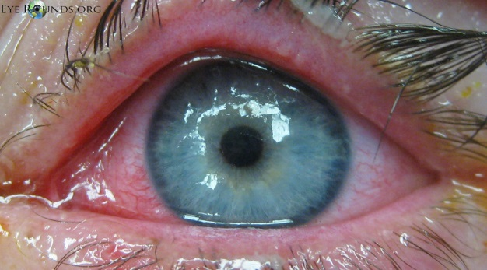
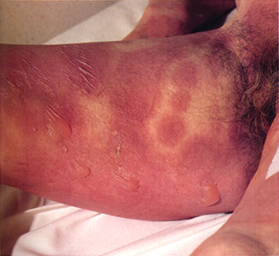
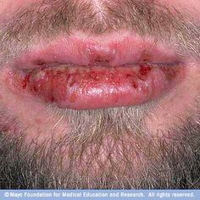
Patient presents to ED with a painful rash
Notes:
A patient presents to your ED with a painful rash as shown with Mucositis, conjunctivitis, and a blistering rash to the groin.

Slide 4
Patient history
Presentation:
3/7 fevers, body aches with associated skin rash and blisters
Past Medical History:
Hypertension, Ischaemic heart disease, and Dyslipidemia
Diagnosis of epilepsy by GP several weeks ago.
Prescribed Carbamazepine 200mg twice daily 2 weeks ago
What is your Differential Diagnosis and underlying cause?
Notes:
Patient presents with 3/7 fevers, body aches with associated skin rash and blisters.
With a past medical history of Hypertension, Ischaemic heart disease, and Dyslipidemia.
He was recently diagnosed with epilepsy by GP several weeks ago.
What is your differential diagnosis and potential underlying cause for this patient’s presentation?
Differential Diagnosis is
Staphylococcal scalded skin syndrome
Pemphigus vulgaris
Bullous pemphigoid

Slide 5
Steven Johnsons Syndrome
What do you think caused it?
  Carbamazepine
How would you classify this adverse drug reaction?
  Serious / life threatening
Notes:
Primary diagnosis is Steven Johnsons Syndrome caused by carbamazepine which is a serious adverse drug reaction
A slight warning, the next slide will have some very graphic pictures of what may happen to the patient if it wasn’t reported and the patient continued to take the medication or was re-introduced the same medication

Slide 6
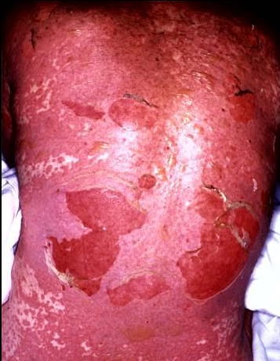
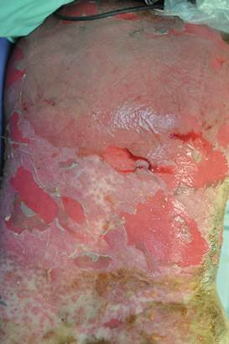
What may happen without reporting?
TOXIC EPIDERMAL NECROLYSIS
Notes:
Toxic Epidermal Necrolysis – warn about graphic images about to be shown (images appear on click)

Slide 7
Serious Adverse Drug Reactions:
A serious adverse drug reaction requires hospital admission or increased length of stay (LOS), results in persistent or significant disability / incapacity or is life-threatening and may result in death.
It is an absolute or relative contraindication to repeat administration of the drug.
Notes:
How do we define a serious adverse drug reaction?
How can we ensure that this incident does not recur again?

Slide 8
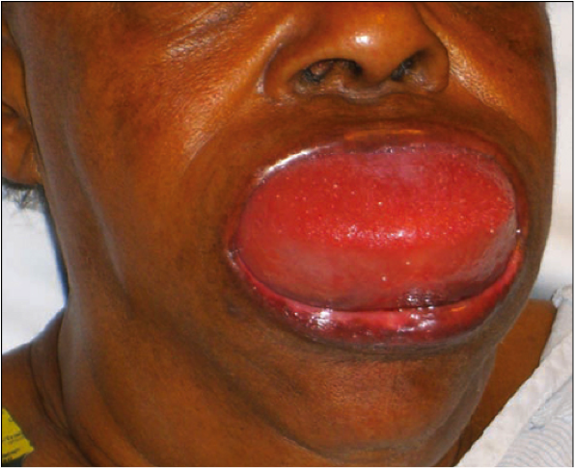
What can be done to prevent this?
REPORT IT!
Notes:
By reporting it!
This is a Picture of someone with angioedema

Slide 9
What is your role in the event of an ADR or clinical alert
Complete all documentation including a ‘Clinical Alert notification’ form when a serious ADR or clinical alert is detected
Informing patient of the ADR episode
Change patient’s bracelet to RED if new ADR
Provide patient with ADR brochure to notify GP and health care providers
A serious ADR should be raised as a Clinical Alert as per WA Clinical Alert Policy
Notes:
As clinicians we are responsible for asking whether the patient has had any past adverse drug reactions, and clarifying which drug and what reaction has occurred (and if possible when it occurred)
When a serious ADR is identified it should be raised as a clinical alert by using the Clinical Alert form or the MR002 form. This form should be submitted for review by your local Clinical Alert Committee and added onto TOPAS/WebPAS.
The details of the episode should be clearly documented in the notes.
A brief description of the reaction should be outlined on the submission form to assist with the approval process
The patient should be notified of the adverse event and provided with a brochure as well as have the incident documented on the patient’s discharge summary for communication with patient’s care provider

Slide 10
What is your role in the event of an ADR or clinical alert
Notes:
This is a copy of an ADR brochure where medication related ADRs, as well as serious ADRs that are deemed clinical alerts, can be completed and given to patient for future reference.

Slide 11
Where to document?
  National Inpatient Medication Chart (NIMC) and any supplementary charts/proforma
  Patient’s progress notes
  Discharge summary (e.g. CGMS/NaCS)
  Record in pharmacy dispensing database
  Report to TGA as appropriate
  Submit a Clinical/Med Alert notification for inclusion on PAS
Notes:
Some other places where the ADR or medication related Clinical Alert must be documented.

Slide 12
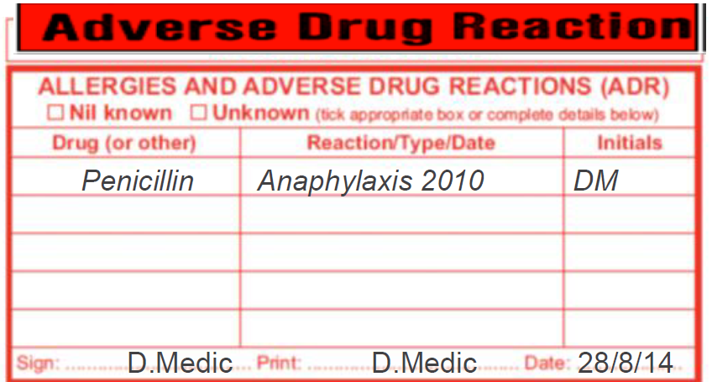
NIMC Chart
ADR Sticker/Label
Drug involved and Details of reaction
Date of reaction (if known)
Clinician signature and date
Notes:
This is an example of how to record an ADR or medication related Clinical Alert on the NIMC. Note that the medication or class of medication should be clearly identified and the reaction and date of reaction annotated on the NIMC and also in the patient’s progress notes.

Slide 13
Clinical Alert - Definition
“A Clinical Alert is critically important information to a patient’s management during the first 24 hours of their admission to hospital assuming that the patient is not always capable of communicating such vital information.”
Clinical alerts are divided into 3 categories
  Anaesthetic alerts
  difficult intubation, malignant hyperthermia
  Medical alerts
  implantable pacemaker, heart valve replacement
  Medication alerts
  anaphylaxis, angioedema
Report all clinical alerts
Notes:
The definition of a clinical alert is…….
Clinical alerts are divided into 3 categories
Anaesthetic
Medical alerts and
Medication alerts
The anaesthetic alerts are usually reported by the anaesthetists or anaesthetic technicians
Medical alerts are usually identified by the medical team while the patient is hospitalised or the clinical coders when they review the patient’s medical notes and also operation/procedural notes
Medication alerts is one category where the responsibility to report lies with the treating medical team or pharmacist to submit a clinical alert. It requires active engagement from the medical team

Slide 14
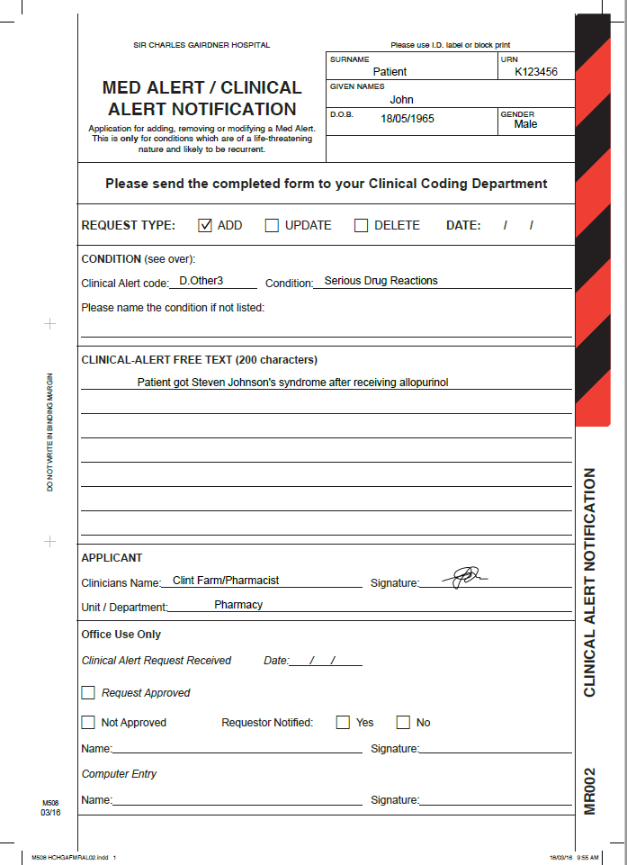
MED ALERT/CLINICAL ALERT NOTIFICATION
FRONT
This form is available on the ward or from Medical records
May refer to immunology or other specialty for further testing and follow up via eReferral system
This form must be completed and submitted urgently so that it can be put onto the Patient Administration System (PAS)
Notes:
This is what the Clinical alert form looks like.
You may add, update or delete a Clinical alert for a patient.

Slide 15
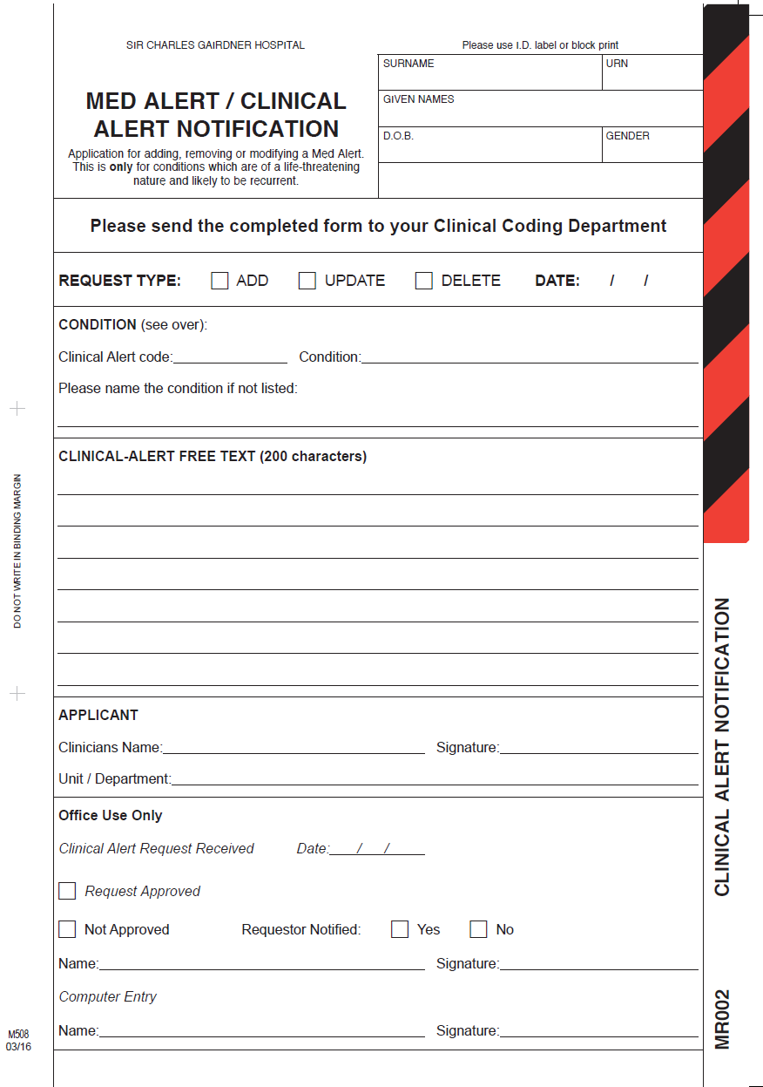
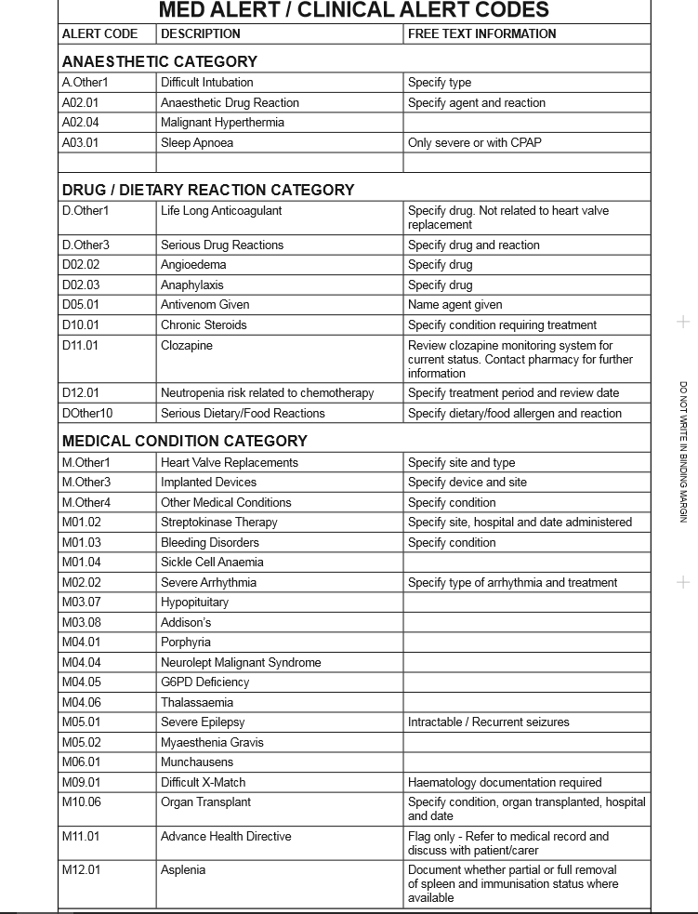
Clinical Alert forms
Notes:
The back of the form outlines the categories of clinical alerts that are reportable.
Should your patient fall into any of these categories a Clinical Alert form should be raised.
As mentioned earlier, we will be focusing on the medication related clinical alerts as this area is still a working progress in many hospitals
If there does not seem to be a clinical alert category available, and you feel it should be added to the list, it should be raised to the Clinical Alert Business User Group to determine whether it can be added as an official clinical alert.

Slide 16
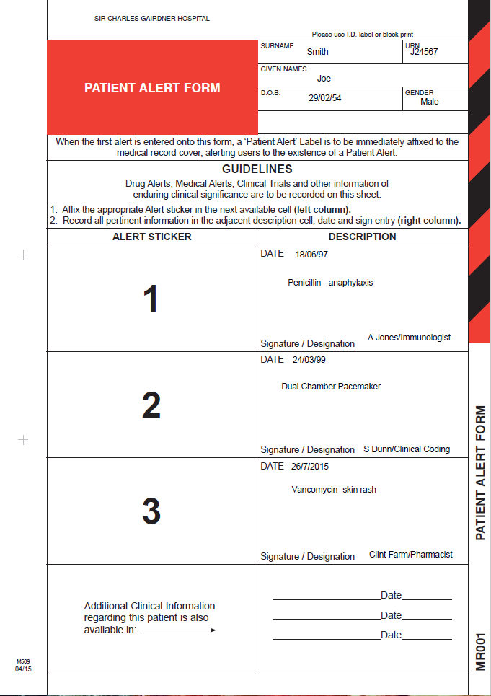
Clinical Alert forms
This will be in the front of the patient’s current medical record admission folder
This is where clinical alerts, medical alerts and other information of clinical significance are recorded
Drug allergies which are not clinical alerts, clinical trials can also be recorded and updated on this sheet
Notes:
The Patient Alert Form is a summary of the Clinical Alerts and also any other non-clinical alert such as clinical trials, ADRs that are in a patient’s record.
This should accompany the patient’s current medical record and is located in the front page of the records (or headsheet)

Slide 17
Clinical alert
PAS process
Clinical alert can be identified by
  Clinical pharmacist
  Clinical coding staff
  Medical and nursing staff
Clinical Alert Form generated.
Alert form reviewed by hospital Clinical Alert Committee or equivalent and approved for entry onto PAS by coding staff.
Notes:
Clinical alert can be identified by the patient’s medical team, pharmacist, nurses staff or clinical coders, but the Clinical Alert form should be raised by the treating medical team and/or pharmacist (for medication related alerts)
PAS = Patient administration system i.e. TOPAS or webPAS.

Slide 18
How do you know when a patient has a reported Alert?
It will appear on iSOFT Clinical Manager as
  “MED ALERT EXISTS FOR THIS PATIENT” on top right had corner of screen when patient selected.
By clicking on Allergies/Comments tab for that patient, it will display the details of the alert
Notes:
Example shown on next 2 slides.

Slide 19
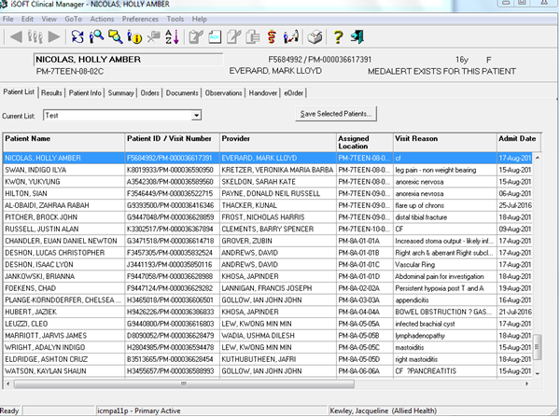


iSOFT – Patient List
Notes:
When on an iSOFT patient list screen, the patient information of the patient highlighted in blue appears on the banner bar and the ‘MEDALERT EXISTS FOR THIS PATIENT’ appears as you scroll through the patient.
To see details of the med alert, select the patient and click onto the ‘patient info’ tab (next slide).

Slide 20
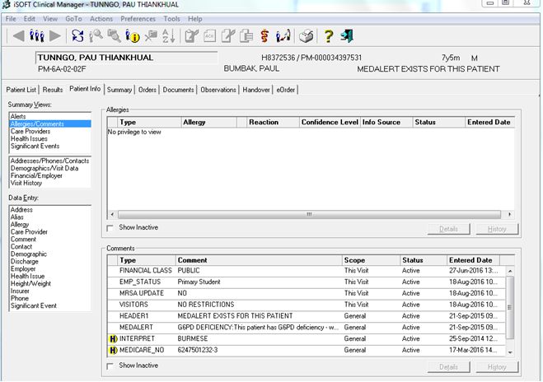

iSOFT Patient Info
Notes:
Patient selected, the ‘MEDALERT EXISTS FOR THIS PATIENT’ appears on the patient banner in the top right corner and the details of the med alert can be seen when the ‘patient info’, ‘allergies/comments’ tab is selected.
Description of the med alert appears in the line below the med alert header.

Slide 21
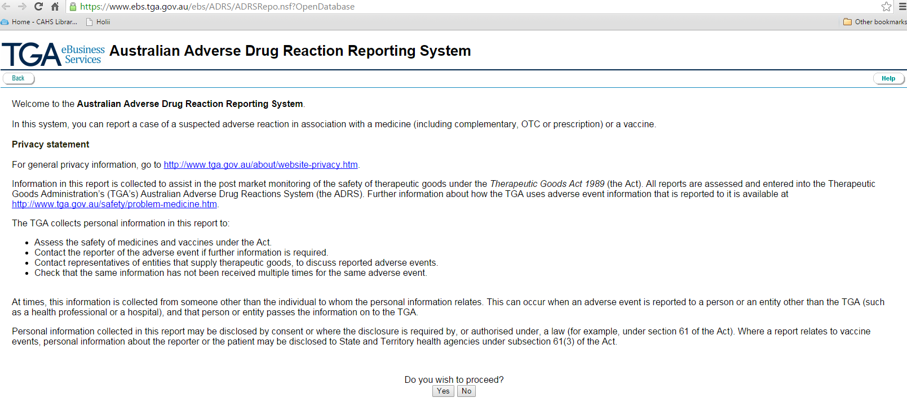
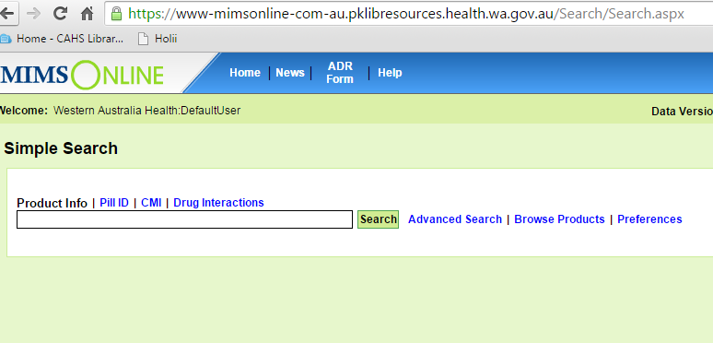
Reporting to TGA
National post-marketing Adverse Event monitoring
  Database of Adverse Event Notification (DAEN)
    Medicines and Medical Devices
Report via
  MIMS (WA Health Libraries)
  TGA directly
Notes:
MIMS screen shot and TGA screen shot will appear with 1 click on, 1 click off for each image.

Slide 22
Incidents to report to TGA:
Who can report to the TGA? Anyone can
Each year the TGA receives more than 16,500 reports of suspected adverse events to medicines and vaccines
You don't need to be certain, just suspicious!
Every report counts.
All reports help to build a picture of the safety profile of a product and assist with the TGA's safety monitoring program.

Slide 23
Incidents to report to TGA:
The TGA particularly needs to know:
all suspected adverse events to new therapeutic goods
all suspected medicine and/or vaccine interactions
adverse events that do not appear in the Product Information, Consumer Medicine Information and/or product labelling)
serious adverse events

Slide 24
Online Learning module
Reporting ADEs– online learning module (CPD points)
http://www.tga.gov.au/safety-through-reporting-online-learning-modules-health-professionals

Slide 25
Reporting summary
Notes:
This is a process map summary for what to do in an event of an ADR and a clinical alert

Slide 26
In Summary
A Clinical Alert is critically important information to a patient’s management at presentation to hospital, during their admission and for future admissions.
It is important to report Clinical Alerts to ensure all clinicians involved in the patient’s care are aware of potential life-threatening situation that may alter future management.
Clinical alerts available via the PAS are visible across all WA Health sites

